Slide 1
Salesforce Identity: Don’t Treat Your Customers Like Your Employees
Ian Glazer
Senior Director, Identity
@iglazer
Chuck Mortimore
VP, Product Management Identity
@cmort

Slide 2
Safe Harbor
Safe harbor statement under the Private Securities Litigation Reform Act of 1995:
This presentation may contain forward-looking statements that involve risks, uncertainties, and assumptions. If any such uncertainties materialize or if any of the assumptions proves incorrect, the results of salesforce.com, inc. could differ materially from the results expressed or implied by the forward-looking statements we make. All statements other than statements of historical fact could be deemed forward-looking, including any projections of product or service availability, subscriber growth, earnings, revenues, or other financial items and any statements regarding strategies or plans of management for future operations, statements of belief, any statements concerning new, planned, or upgraded services or technology developments and customer contracts or use of our services.
The risks and uncertainties referred to above include – but are not limited to – risks associated with developing and delivering new functionality for our service, new products and services, our new business model, our past operating losses, possible fluctuations in our operating results and rate of growth, interruptions or delays in our Web hosting, breach of our security measures, the outcome of any litigation, risks associated with completed and any possible mergers and acquisitions, the immature market in which we operate, our relatively limited operating history, our ability to expand, retain, and motivate our employees and manage our growth, new releases of our service and successful customer deployment, our limited history reselling non-salesforce.com products, and utilization and selling to larger enterprise customers. Further information on potential factors that could affect the financial results of salesforce.com, inc. is included in our annual report on Form 10-K for the most recent fiscal year and in our quarterly report on Form 10-Q for the most recent fiscal quarter. These documents and others containing important disclosures are available on the SEC Filings section of the Investor Information section of our Web site.
Any unreleased services or features referenced in this or other presentations, press releases or public statements are not currently available and may not be delivered on time or at all. Customers who purchase our services should make the purchase decisions based upon features that are currently available. Salesforce.com, inc. assumes no obligation and does not intend to update these forward-looking statements.

Slide 3
Ian Glazer
Senior Director, Identity
@iglazer

Slide 4
Chuck Mortimore
VP, Product Management Identity
@cmort

Slide 5




The Disruptors

Slide 6
Welcome to Customer Identity

Slide 7

The opportunity ahead of us…

Slide 8


Build a Complete Picture for Delighted Customers
Delighted Customers
Notes:
Every part of the business gets an accurate current picture of the customer
Baby-steps towards recognition
The first one to form a relationship will win
If you don’t, your competitor will

Slide 9
Across Business Functions
Sales
Service
Delighted Customers
Product
Marketing
Notes:
Every part of the business gets an accurate current picture of the customer
Baby-steps towards recognition
The first one to form a relationship will win
If you don’t, your competitor will

Slide 10

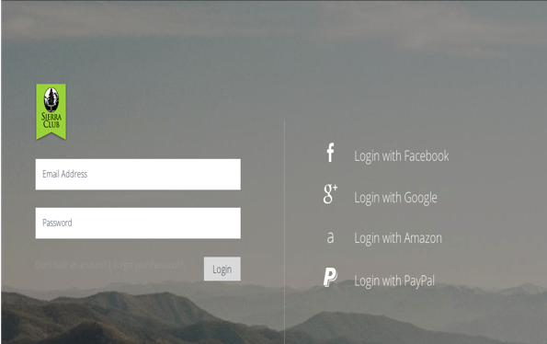



Omni-Channel
Mobile
Web
API
Brick & Mortar Sales
Social Listening
Call Center
Notes:
We might be tempted to think of cross-channel as web, mobile, and API, but it is more than that. In a non-IT-centric setting, cross-channel includes things such as brick and mortar sales and points of presence, social listening, and call centers.

Slide 11
Identity for Employees

Slide 13
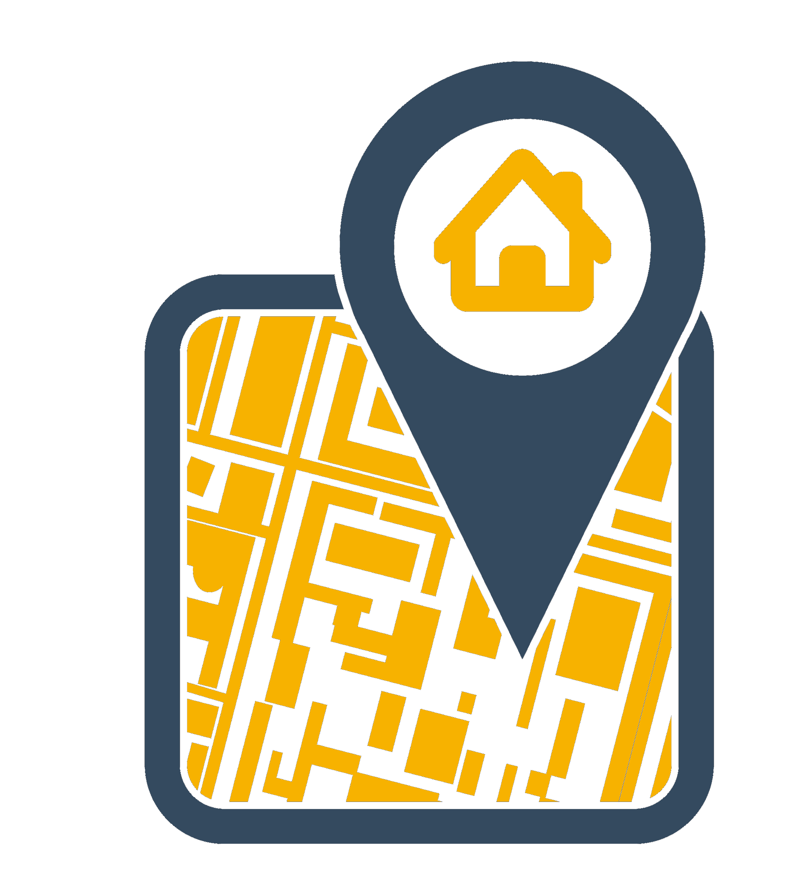

Right Place
Right Time

Slide 14

Right People
Right Place
Right Time

Slide 15

Right Access
Right People
Right Place
Right Time

Slide 16
Identity for Customers
Notes:
When it comes to identity services for customers, consumers, citizens our industry doesn’t have the same maturity. There is a great deal of innovation in this area to be sure. In pursuit of external identity this industry has created notions of user-centric identity and personal data stores – all great achievements. But there is not a lot in the way of common patterns or practices. To serve our citizens and our customers we need to deliver the right experience to the right person at the right time and in the right place.

Slide 18
Right Place
Right Time

Slide 19
Right People
Right Place
Right Time

Slide 20
XP
Right Experience
Right People
Right Place
Right Time

Slide 21
Comparing user experiences
Which would you rather provide?
Employees
Open a ticket
Wait for access
Open another ticket
Ask a colleague
Use someone else’s account
Customers
Social Sign-On
Immediate access
Single Sign-On everywhere
Ability to engage across all channels

Slide 22
Delight Customers with Salesforce Identity

Slide 23
Single view of the customer as a vehicle to greater service

Slide 24
Who do we want to serve?
Who
Prospects
Customers
Students
Partners

Slide 25

What services do we need to provide?
Who
What
Prospects
Salesforce Apps
Customers
Mobile Apps
Students
Partners
Custom Apps
Existing Web Properties

Slide 26





Where are our customers coming from? When do we need to serve them?
Who
Where When
What
Prospects
Username & Password
Salesforce Apps
Customers
Mobile Apps
Students
Partners
Custom Apps
Existing Web Properties

Slide 27
How do we do this: The Challenge
Who
Where When
How
What
Prospects
Username & Password
Salesforce Apps
Customers
Mobile Apps
Students
Partners
Custom Apps
Existing Web Properties

Slide 28

How do we do this: The Answer
Who
Where When
How
What
Prospects
Username & Password
Salesforce Apps
Customers
Mobile Apps
Students
Partners
Custom Apps
Existing Web Properties

Slide 29
Why have we started on this journey?
Who
Where When
How
What
Why
Prospects
Username & Password
Increased Engagement
Salesforce Apps
Customers
Omni-channel Experiences
Mobile Apps
Convenience & Control
Students
Partners
Custom Apps
Growth
Existing Web Properties

Slide 30
Single view of the customer as a vehicle to greater service
Who
Where When
How
What
Why
Prospects
Username & Password
Increased Engagement
Salesforce Apps
Customers
Omni-channel Experiences
Mobile Apps
Convenience & Control
Students
Delighted Customers
Partners
Custom Apps
Growth
Existing Web Properties

Slide 31




Single view of the customer as a vehicle to greater service
Who
Where When
How
What
Why
Prospects
Username & Password
Increased Engagement
Salesforce Apps
Customers
Omni-channel Experiences
Mobile Apps
Convenience & Control
Students
Delighted Customers
Partners
Custom Apps
Growth
Existing Web Properties

Slide 32
How does Salesforce Identity delight customers?

Slide 33






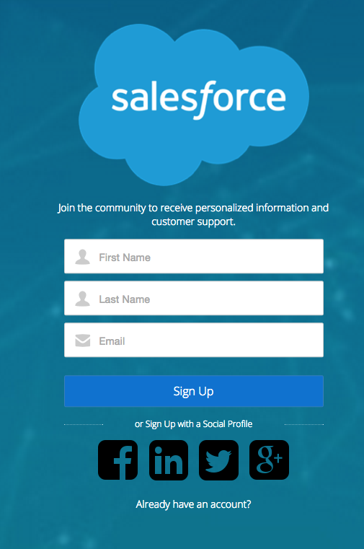
Social Sign-on and User Registration
Where: Make it simple for users to connect
Social Login
Make Contacts active
Reduce end-user friction via 3rd party identities
Facebook, Google, LinkedIn, Twitter, PayPal
Extensible for regional social networks
Simple Registration
Social login simplifies new user sign-up
Social profiles enhance personalization
3rd party verification and proofing services
Trigger workflows
Notes:
The Salesforce Platform is the #1 cloud platform for Developers, Business Experts, and ISVs. It’s also the leading cloud platform according to IDC with 40% market share.
Customers have built over 3 million applications, and they have installed over 1 million applications through the AppExchange.
Customers of all sizes and across all industries, like Coca Cola, Levi’s, Facebook, and AT&T, are delivering innovation to their employees and customers now with the Salesforce Platform.
The Salesforce Platform is processing over 70 billion transactions per quarter and 1B transactions a day.

Slide 34
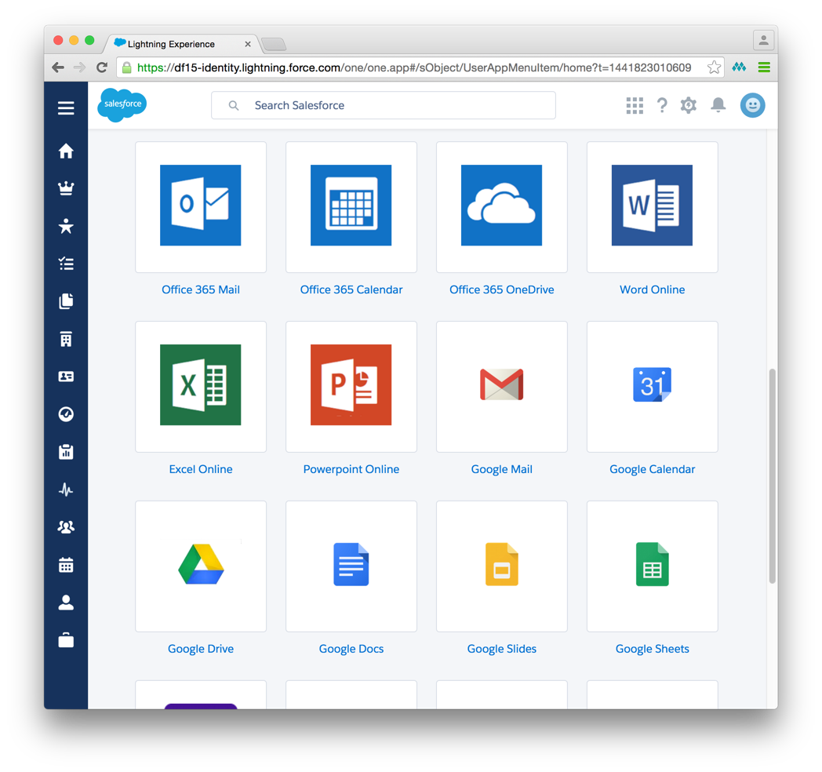
Federation, Single Sign-On, and Authentication
What: Connected to Apps
Standards-Based and Extensible
SAML
OpenID Connect
OAuth 2
SCIM
Delegated Authentication
Canvas APIs
Authentication, Policy and Access control
Built-in OTP two-factor and step-up authentication
Unphishable Out-Of-Band 2FA (Coming Soon)
Risk-based authentication
3rd party strong authentication support
Enterprise control over OAuth
Notes:
The Salesforce Platform is the #1 cloud platform for Developers, Business Experts, and ISVs. It’s also the leading cloud platform according to IDC with 40% market share.
Customers have built over 3 million applications, and they have installed over 1 million applications through the AppExchange.
Customers of all sizes and across all industries, like Coca Cola, Levi’s, Facebook, and AT&T, are delivering innovation to their employees and customers now with the Salesforce Platform.
The Salesforce Platform is processing over 70 billion transactions per quarter and 1B transactions a day.

Slide 35



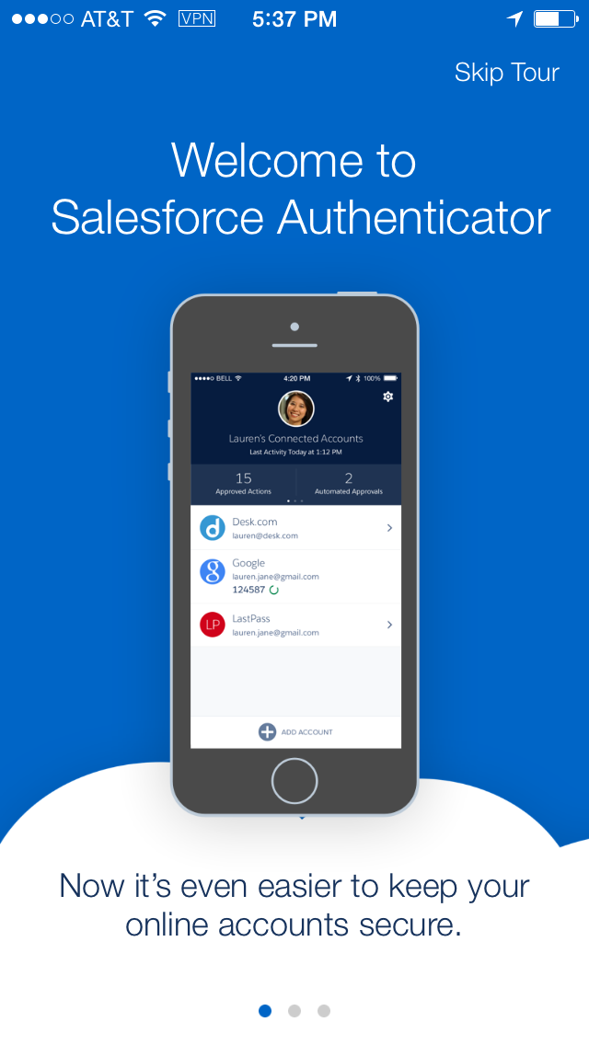
Identity services for mobile devices
Mobile Identity
What: Deploy Once; Use Everywhere
Salesforce apps
Quick deploy of mobile SSO in Salesforce1
Common user admin functions in SalesforceA
OTP in Salesforce Authenticator
Custom apps
Build custom mobile on iOS and Android in minutes
Fully open-source and standards based
Custom permissions
Social sign-on
Enterprise control
Single Sign-On
Pin protection
Two-factor authentication
Delegate authentication process to native browser
Central Reporting
Notes:
The Salesforce Platform is the #1 cloud platform for Developers, Business Experts, and ISVs. It’s also the leading cloud platform according to IDC with 40% market share.
Customers have built over 3 million applications, and they have installed over 1 million applications through the AppExchange.
Customers of all sizes and across all industries, like Coca Cola, Levi’s, Facebook, and AT&T, are delivering innovation to their employees and customers now with the Salesforce Platform.
The Salesforce Platform is processing over 70 billion transactions per quarter and 1B transactions a day.

Slide 36


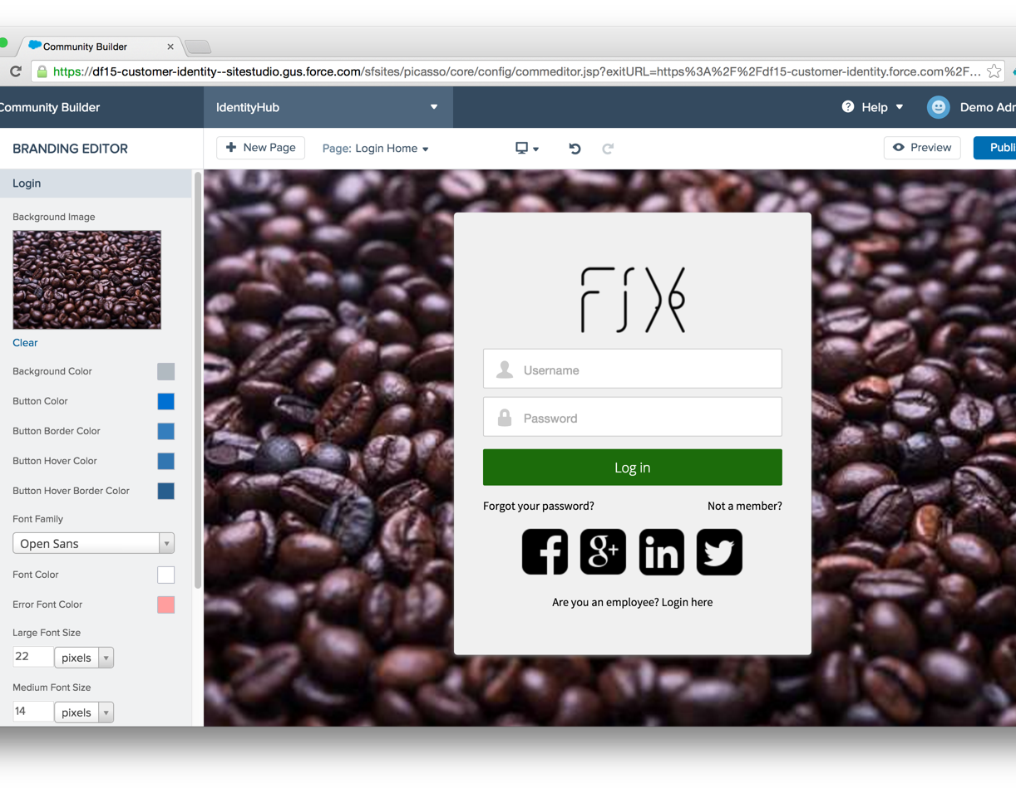
Brand control
Brandable Services
How: Delivering a great user experience
Declarative and Programmatic Branding
Login Page for employees and extended enterprise
Community Builder
App Launcher
Profile Page
Salesforce1
Notes:
The Salesforce Platform is the #1 cloud platform for Developers, Business Experts, and ISVs. It’s also the leading cloud platform according to IDC with 40% market share.
Customers have built over 3 million applications, and they have installed over 1 million applications through the AppExchange.
Customers of all sizes and across all industries, like Coca Cola, Levi’s, Facebook, and AT&T, are delivering innovation to their employees and customers now with the Salesforce Platform.
The Salesforce Platform is processing over 70 billion transactions per quarter and 1B transactions a day.

Slide 37
Getting Going: Demo 1

Slide 38
What you are about to see
Community Builder
Global Auth. Provider
Registration Handlers
Community administration

Slide 39
Connecting Apps: Demo 2

Slide 40
What you are about to see
SSO to 3rd party web sites
Mobile SDK

Slide 41
Driving Engagement: Demo 3

Slide 42
What you are about to see
Connected App Plugins
Salesforce Marketing Cloud Connector
Mobile identity services
Notes:
connected app plugin create lead on authorize

Slide 43
Putting it all together, Delighting customers

Slide 44
Salesforce Identity Components in Action
Where to go in Setup to make the magic happen
Requirement | Reason | In Setup
Quick and Easy Registration | Make engagement easier | Auth. Providers
Social Sign-On | Reduce friction Grow the audience | Auth. Providers
Create Accounts, PersonAccounts, Contacts, & Users during registration | Our contact data is our gold! | Registration Handlers
Single Sign-On | Seamless user experience | Connected Apps
Enforce SSO policy and enhance attributes | Greater control and enhanced personalization | ConnectedAppPlugins
Send emails the 1st time a user logs in | Drive cross-channel engagement | Salesforce Marketing Cloud Connector*

Slide 45
Learn More about Salesforce Identity
Attend other identity sessions. View list at salesforceidentity.info
How-To
developer.salesforce.com/page/Identity
Salesforce Identity on YouTube
On GitHub
Ask questions
Join “Salesforce Identity” Chatter group on success.salesforce.com
Try out
Sign-up for a DE org or contact your AE to try it in your sandbox org

